Slide 1

CodeU Class 6 Welcome!
The class will start shortly
Reproduction and distribution of the presentation deck is prohibited

Slide 2
Agenda for today’s class
Recap of last class
01
02
Homework correction
To refresh our minds!
We’ll revise the hw to understand better
Topics of the day:
03
04
Practice time!
Learn how to code like a pro!
For Loop
Continue and Break statements
Wrap-up
Conclusion
05
06
CodeU Robot
Summary of what we’ve learned today
homework and questions

Slide 3

First Exercise: CodeU Amusement Park!
01
You’ve. Been hired by the CodeU Amusement Park to help them out with an issue. They’ve given you a list of people’s heights and asked you to determine how many people there are, and how many are allowed to ride the rollercoasters. The height requirement is 140 cm. Help them by building a code that will give them the answers they are looking for!
Here is the list of people and their heights:
heights = [208, 200, 137, 141, 127, 145, 134, 250, 190, 133, 127, 201, 206, 142, 147, 115, 187, 178, 170, 175]
You must create a variable for the number of people over 140 cm and a variable for the total number of people (Hint: The total number of people can be found using a List Manipulation technique)
You then have to create a For Loop that navigates through the heights in the list and only counts the ones that are greater than 140.
Print() a message letting the CodeU team the results

Slide 4
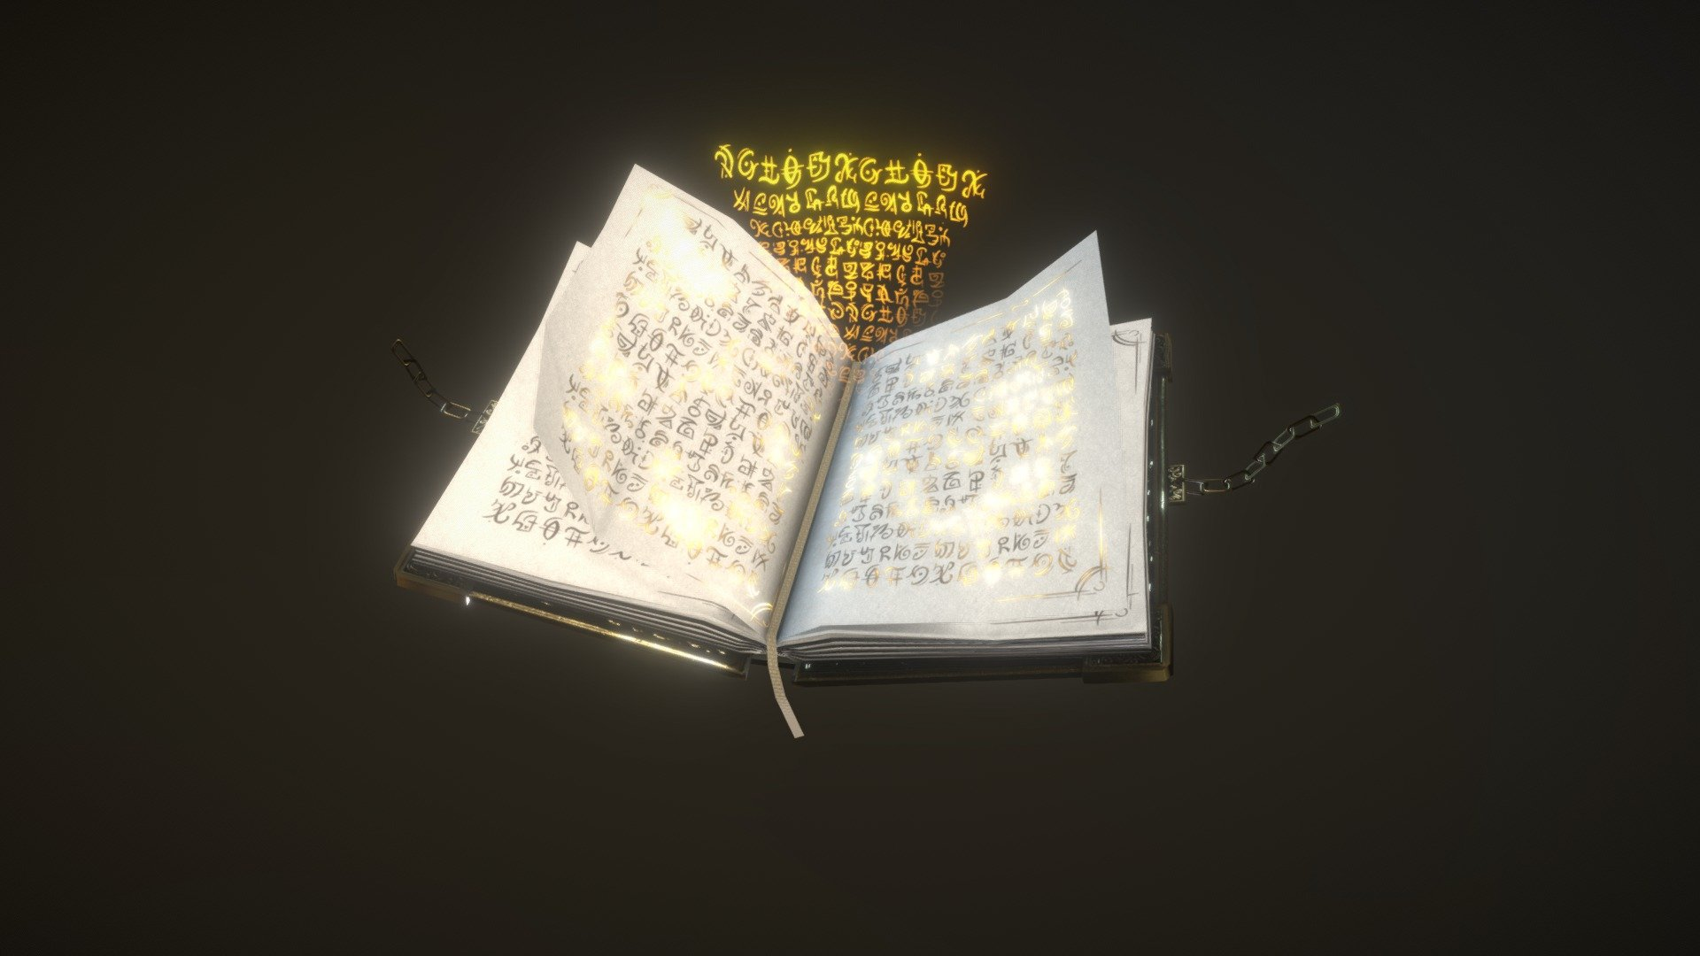
How many a’s are there?
LEVEL: EASY
02
Description
You are given the word ABRACADABRA and you must determine the exact number of a’s in that word.
Create a variable containing the requested String
Create another variable that will determine the number of a’s
You will then create a For Loop that navigates through the String
Inside the Loop, create a conditional (IF) where each time the For Loop reads an a, 1 is added to the variable that determines the count.
Print a message that shows the number of a’s in the word

Slide 5

How many a’s are there?
LEVEL: MEDIUM
Description
You must determine the number of a’s in ANY word given by a user.
Create a variable containing an INPUT that asks the user what word the would like to write.
Create another variable that will determine the number of a’s
You will then create a For Loop that navigates through the String
Inside the Loop, create a conditional (IF) where each time the For Loop reads an a, 1 is added to the variable that determines the count.
Print a message that shows the number of a’s in the word
This Photo by Unknown Author is licensed under CC BY-SA-NC

Slide 6

How many a’s are there?
LEVEL: HARD
Description
You are given a List of several words. You must determine the amount of a’s in the ENTIRE List.
Create a variable containing the List
Create another variable that will determine the number of a’s
You will then create a For Loop that navigates through the List
Inside the Loop, you will create a New For Loop that navigates through the word retrieved by the initial Loop. We call this a NESTED LOOP.
Inside the Nested Loop, create a conditional (IF) where each time the For Loop reads an a, 1 is added to the variable that determines the count.
Print a message that shows the number of a’s in the word
This Photo by Unknown Author is licensed under CC BY-NC-ND

Slide 7
Continue and Break Statements!
03
What is Continue?
A ”continue" Loop Statement is used to skip a part of the loop where a condition is filled and continue the rest of the loop.
For example, if we want to count the amount of students who passed an exam, we will count each passing grade and skip over all failing grades.
What is Break?
A ”break" Loop Statement is used to terminate a While or For Loop once a condition is filled.
For example, if you are trying to guess a number, the question will be repeated if your guess is wrong. If your guess is right, the question isn’t asked anymore.

Slide 8

Let’s practice!
01
Print all numbers under and equal to 3
for i in range(5):
if i >= 3:
print(i)
break
Print all the elements in the following list EXCEPT Python
languages = ["Java", "C#", "C++", "HTML", "Javascript", "Rust", "Perl"]
for i in languages:
if i == "Python":
continue
else:
print(i)
03
02
You have to guess the right answer
number = 5
while True:
answer = int(input("Guess the . correct number: "))
if answer == number:
break
print("That's the correct answer!")

Slide 9

Quick! Change my report card!
04
Goal
You’ll need to create a new list containing just the passing grades using CONTINUE!
Here is the report card
reportCard = [74,59,42,66,45,85,37,47,48, 63, 52, 16, 37,28,83,95,36,62,60,60,14]
Create a variable with an empty list. This list will contain the passing grades
Create a For Loop that will navigate all the grades
Inside the Loop, create an If condition that only accepts grades UNDER 60. If the condition is filled, the loop must skip over that loop. If the condition isn’t filled, add that grade to the new report card.
Print() the final report card!
My Situation
Hi, my name is Alex and I am currently failing some of my classes… If my mom finds out, she’d kill me! The passing grade is 60, so I can’t keep anything under that. I need YOUR help to update my report card and only keep the passing grades.

Slide 10

Homework: Aliens?
Homework Description
The CIA is currently investigation a TOP SECRET case. There is a remote island in the Caribbeans that they think is very suspicious. Using satellites and radio, they're able to pick up weird and unusual signals.
They decide to send in a spy to scout the area and see what's going on. As she explores the island, she spots a weird moving shape from the distance. She gets closer and sees that it's...aliens!
As soon as she realizes, she runs away to hide while calling the CIA to let them know. However, as she was running, she dropped the cellphone in a puddle. She was only able to let them know that there are aliens, but not how many there were. She remembered seeing a radio near where the aliens were stationed. So, at night, she decided to infiltrate their camp to use their radio to communicate with the CIA.
Unfortunately, she could only communicate using different sequences of binary code (1101, 010, 0011, ...). It's common knowledge at the CIA that all 1's represent an enemy.
It is your duty to decrypt this message and determine how many aliens are currently on the island!
Here is the encrypted message:
encryptedMessage = ["110010", "00000011", "10101", "111111110", "00110011010101010", "110100110110101", "110011100011110000"]
1
Create a variable that will contain the amount of aliens. This will be your “alien counter”
Create a Loop that navigates the encrypted message. Inside this loop, you will the create a Nested Loop to navigate the index/string retrieved by the initial loop.
2
3
Inside the nested loop, create an IF condition that only accepts “1”. If the condition is filled, add 1 to your alien counter

Slide 11

Homework Solution: Aliens?
05
Set your alien counter
aliens = 0
Build your code
for i in encryptedMessage:
for j in i:
if j == "1":
aliens += 1
Print a message containing the number of aliens on the island!
print("There are currently " + str(aliens) + " on the island!!")

Slide 12



Thank you!
Does anyone have any questions?
Next class: class 7!
Phone:
(438) 391-9106
Please contact us to make any change in the schedule for the next class.
Email:
siva.sri14@hotmail.com
hello@codeu.ca
Website:
https://www.codeu.ca/
Reproduction and distribution of the presentation deck is prohibited

